Slide 1
Fake Job Detection Using Machine Learning
Submitted in the partial fulfillment for the award of the degree of
BACHELOR OF ENGINEERING
IN
Big Data Analytics
Submitted by:
RITIK(20BCS4361)
M VAIBHAV KUMAR(20BCS4398)
GAURAV KUMAR TIWARY(20BCS3986)
ABHIMANYU(20BCS3975)
Under the Supervision of:
Asst. Prof. Rituparna Seal
Department of AIT-CSE
DISCOVER . LEARN . EMPOWER

Slide 2

Outline
Introduction
Scope of the Project
Planning to implement

Slide 3

Introduction
The rise of fake job postings.
Detecting deceptive employment listings.
How machine learning fights job scams.
Our approach to fake job detection.
Tackling employment fraud with technology.

Slide 4
Scope of the Project
Scope of our fake job detection initiative.
Identifying fake job postings across the web.
Analyzing job descriptions and user behavior.
Extending our solution to diverse job markets.
Enhancing trust in online job searching.

Slide 5
Planning to implement
Collecting a diverse dataset of job postings from multiple online platforms.
Extracting meaningful features from job descriptions and associated metadata.
Evaluating various machine learning algorithms to identify the most effective approach.
Developing a robust pipeline for model training and optimization.
Planning for real-time integration and continuous monitoring in an online environment.

Slide 6
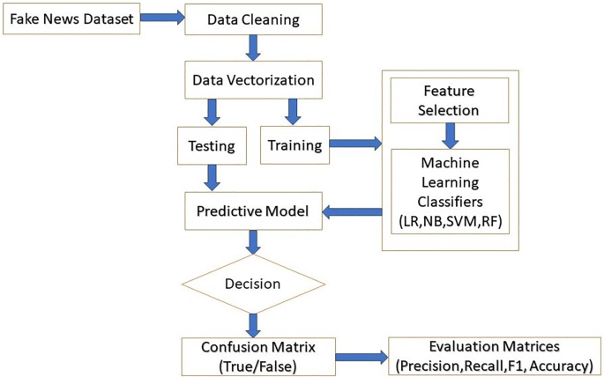

Slide 7
Preliminary Design
Dataset Exploration: Exploring the dataset to understand size, structure and distribution.
Feature Selection: Extraction of features including textual and meta-information
Model Selection: Selecting the appropriate ML algorithm.
Evaluation: Defining initial evaluation metrics

Slide 8
Methodology Used
Methodologies used are NLP and Random Forest.
NLP:
NLP is a branch of artificial intelligence that focuses on the interaction between computers and humans through natural language.
It involves the development of algorithms and techniques to enable computers to understand, interpret, and generate human language.
NLP encompasses tasks such as text classification, sentiment analysis, machine translation, and chatbot development, among others.

Slide 9
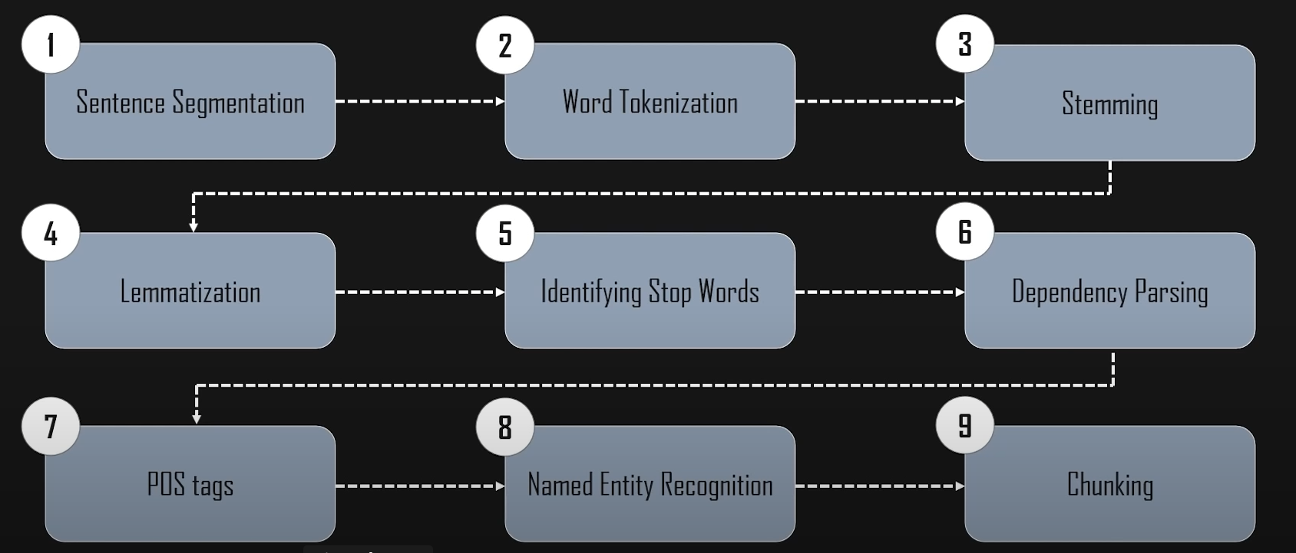
NLP Pipeline

Slide 10
Naive Bayes:
Simple and Effective Classification: Naive Bayes is a powerful algorithm for categorizing data, making it easy to implement and achieving good results in many applications.
Probabilistic Approach: Leveraging Bayes' theorem, it calculates the probability of an instance belonging to a particular class based on its features.
Conditional Independence Assumption: The core idea, though sometimes unrealistic, is that features are independent of each other given the class label. This simplifies calculations but can impact accuracy.

Slide 11
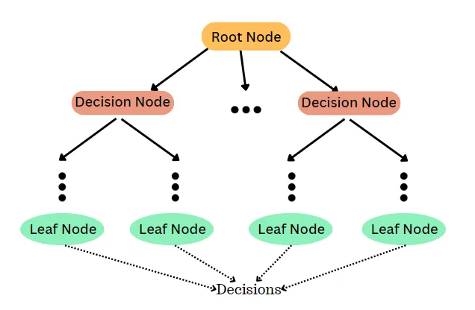
Naive Bayes

Slide 12
Analysis of Features
The Model is capable of distincting the Fake Jobs from the Real jobs.
Future Updates:
Deploying it on web.
Feeding real time data.
Live job distinction

Slide 13
Thank you

